Slide 1
A “KISS” APPROACH TO SUCCESSION PLANNING.
Larry Stybel
STYBEL PEABODY ASSOC. INC.

Slide 3
MY GREATEST FAILURE

Slide 4
THE KISS APROACH TO SUCCESSION PLANNING.
The danger of Important/Not Urgent Business Issues and what you can do about it.
Succession planning starts at the top: the KISS approach at the ownership level.
Moving down the organization to institutionalize smooth transitions.

Slide 5
IDEAS TO ACTION WORKSHOP

Slide 7
Matthew Sonfeld et al. “Family Business and the Relationship Between Business Age and Management Activities, Styles, and Practices: a four country analysis.” SMALL BUSINESS INSTITUTE RESEARCH REVIEW, Volume 25, 2008.

Slide 8
2006 U.S. Census
35% of Fortune 500 Companies.
80% of the 15 million U.S. businesses.
50% of U.S. GNP.
50% of U.S. employment.

Slide 9
SONFIELD STUDY: YEARS IN BUSINESS AND SUCCESSION PLANS.
USA
France
Croatia
India

Slide 10
THEY ALL SUCK

Slide 12
88% believe business will be in family in five years……….

Slide 13
12% survive from the second to the third generation.

Slide 14
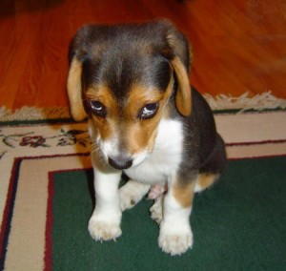
3% survive from the 3rd to the 4th Generation.

Slide 15
WHY SHOULD YOU CARE?
Control Today.
Predict Tomorrow.

Slide 16
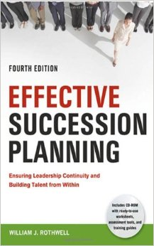
YOU CAN GET AS COMPLEX AS YOU CAN AFFORD……448 pages

Slide 18
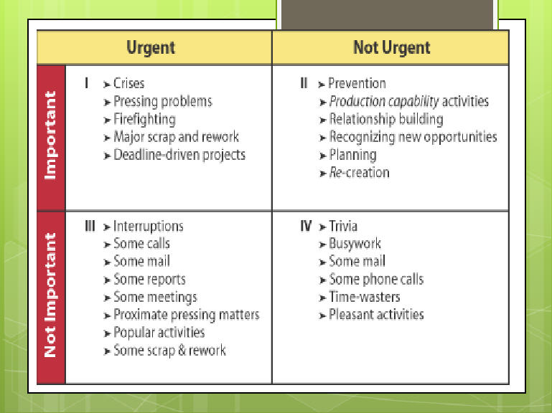

Slide 19
Bring a “real” outsider to your Board with a mandate of holding your feet to the fire in making succession Important AND Urgent.
If you are a family business, do not put the burden onto your family, friends, or business people who depend on you for revenue.
Hire someone five years before you think you need to do it.
Schedule one hour a year of Board meeting to discuss succession issues.

Slide 20
Good Actions Trump Good Intentions.

Slide 24
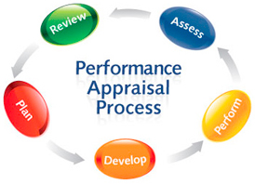

Slide 25
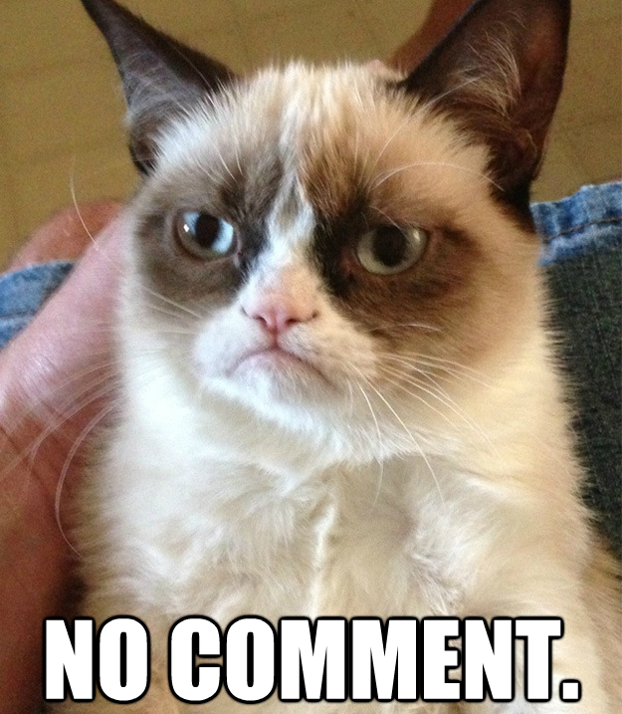
Policy #1: No Promotion Possible Unless Incumbent Identifies and Develops Replacement.

Slide 26
1. Incumbent has identified successor.

Slide 27
2. Incumbent is Developing Successor.

Slide 28
Money Rocks!!

Slide 29
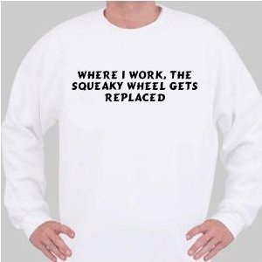
Spend More Time Cultivating High Potentials on Your Team.

Slide 33
KISS Approach to Succession.
Failure to plan means someone else decides….
Succession can move from important/not urgent to important/urgent.
Starts from the top of the company.
To institutionalize, change your compensation system and evaluation system.

Slide 34
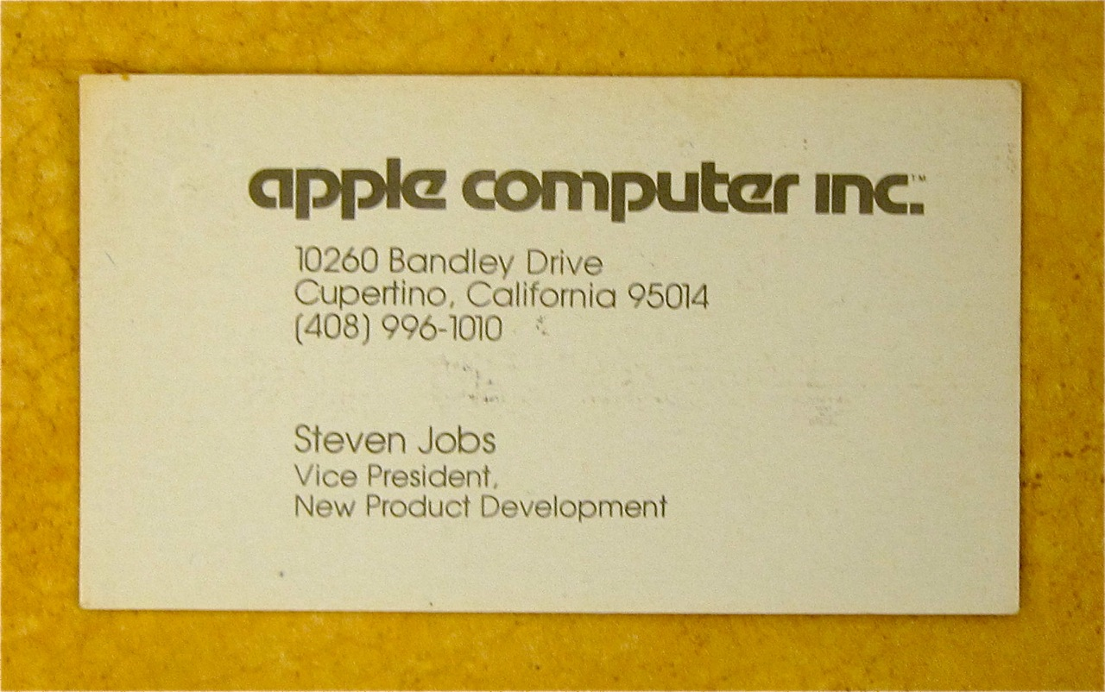
Want a Copy of These Slides?

